Slide 1

LET US C
BY YASHAVANT KANETKAR
CH 6 Q[C]
CH 6 Q[A]
CH 6 Q[B]
CHAPTER 6 SOLUTIONS
MORE COMPLEX REPETITIONS

Slide 2
CHAPTER 6 SOLUTIONS
MORE COMPLEX REPETITIONS
Q[A] What will be the output of the following programs:
CH 6 Q[A]
(a)
#include <stdio.h> int main()
{
int i = 0;
for ( ; i ; )
printf("Here is some mail for you\n");
return 0;
}
CH 6 Q[C]
CH 6 Q[B]
DEAR CODING
(b)
(c)
BOOK: LET US C
BY YASHAVANT KANETKAR

Slide 3
CHAPTER 6 SOLUTIONS
MORE COMPLEX REPETITIONS
(a)
#include <stdio.h> int main()
{
int i = 0;
for ( ; i ; )
printf("Here is some mail for you\n");
return 0;
}
👩‍💻 No Output
CH 6 Q[A](a)
✍️ This C program has a for loop that has an empty condition, and the loop variable i is initialized to 0. Since 0 is treated as false in C, the loop will not execute and the program will exit without producing any output.
DEAR CODING
BOOK: LET US C
BY YASHAVANT KANETKAR

Slide 4
CHAPTER 6 SOLUTIONS
MORE COMPLEX REPETITIONS
(b)
#include <stdio.h> int main()
{
int i;
for (i = 1; i <= 5; printf("%d\n", i));
i++;
return 0;
}
👩‍💻 Output:
Prints 1 infinite times
CH 6 Q[A](b)
✍️ The for loop is terminated with a semicolon. i++ will never execute. So, the value of i will always be 1, which is less than 5. The loop condition I <= 5 will never false. Hence, the control will keep rotating inside the for loop.
DEAR CODING
BOOK: LET US C
BY YASHAVANT KANETKAR

Slide 5

CHAPTER 6 SOLUTIONS
MORE COMPLEX REPETITIONS
(c)
👩‍💻 Output:
#include <stdio.h>
int main()
{
int i = 1, j = 1;
for ( ; ; )
{
if (i > 5)
break;
else
j += i;
printf("%d\n", j);
i += j;
return 0;
}
}
CH 6 Q[A](b)
✍️ This is an indefinite for loop. It has no initialization, no condition, and no increment statement, meaning that it will continue running indefinitely until a break statement is encountered or the program is terminated.
✍️ The loop will run only one time because of the last return 0 statement in the end of for loop. And as i is not greater than five, I + j ( i.e. 2 ) will be assigned to j variable. and the value of j will be printed on the screen.
DEAR CODING
BOOK: LET US C
BY YASHAVANT KANETKAR

Slide 6
CHAPTER 6 SOLUTIONS
MORE COMPLEX REPETITIONS
Q[B] Answer the following:
(a) The three parts of the loop expression of the for loop are:
the i__________ expression
the t__________ expression
the i__________ expression
CH 6 Q[B](a)
DEAR CODING
BOOK: LET US C
BY YASHAVANT KANETKAR

Slide 7
CHAPTER 6 SOLUTIONS
MORE COMPLEX REPETITIONS
Q[B] Answer the following:
(a) The three parts of the loop expression of the for loop are:
the initialization expression
the testing expression
the incrementation expression
CH 6 Q[B](a)
DEAR CODING
BOOK: LET US C
BY YASHAVANT KANETKAR

Slide 8
CHAPTER 6 SOLUTIONS
MORE COMPLEX REPETITIONS
Q[B] Answer the following:
(b) The break statement is used to exit from:
1. An if statement
2. A for loop
3. A program
4. The main() function
CH 6 Q[B](b)
DEAR CODING
BOOK: LET US C
BY YASHAVANT KANETKAR

Slide 9
CHAPTER 6 SOLUTIONS
MORE COMPLEX REPETITIONS
Q[B] Answer the following:
(b) The break statement is used to exit from:
1. An if statement
2. A for loop ✅
3. A program
4. The main() function
CH 6 Q[B](b)
DEAR CODING
BOOK: LET US C
BY YASHAVANT KANETKAR

Slide 10
CHAPTER 6 SOLUTIONS
MORE COMPLEX REPETITIONS
Q[B] Answer the following:
(c) A do while loop is useful when we want that the statements within the loop must be executed:
1. Only once
2. At least once
3. More than once
4. None of the above
CH 6 Q[B](c)
DEAR CODING
BOOK: LET US C
BY YASHAVANT KANETKAR

Slide 11
CHAPTER 6 SOLUTIONS
MORE COMPLEX REPETITIONS
Q[B] Answer the following:
(c) A do while loop is useful when we want that the statements within the loop must be executed:
1. Only once
2. At least once ✅
3. More than once
4. None of the above
CH 6 Q[B](c)
DEAR CODING
BOOK: LET US C
BY YASHAVANT KANETKAR

Slide 12
CHAPTER 6 SOLUTIONS
MORE COMPLEX REPETITIONS
Q[B] Answer the following:
(d) In what sequence the initialization, testing and execution of body is done in a do-while loop
1. Initialization, execution of body, testing
2. Execution of body, initialization, testing
3. Initialization, testing, execution of body
4. None of the above
CH 6 Q[B](d)
DEAR CODING
BOOK: LET US C
BY YASHAVANT KANETKAR

Slide 13
CHAPTER 6 SOLUTIONS
MORE COMPLEX REPETITIONS
Q[B] Answer the following:
(d) In what sequence the initialization, testing and execution of body is done in a do-while loop
1. Initialization, execution of body, testing ✅
2. Execution of body, initialization, testing
3. Initialization, testing, execution of body
4. None of the above
CH 6 Q[B](d)
DEAR CODING
BOOK: LET US C
BY YASHAVANT KANETKAR

Slide 14
CHAPTER 6 SOLUTIONS
MORE COMPLEX REPETITIONS
(e) Which of the following is not an infinite loop?
CH 6 Q[B](e)
1. int i = 1;
while (1)
{
i++;
}
2. for( ; ; );
4. int y, x = 0;
do
{
y = x;
} while ( x == 0
3. int t = 0, f;
while (t)
{
f = 1;
}
DEAR CODING
BOOK: LET US C
BY YASHAVANT KANETKAR

Slide 15
CHAPTER 6 SOLUTIONS
MORE COMPLEX REPETITIONS
(e) Which of the following is not an infinite loop?
CH 6 Q[B](e)
1. int i = 1;
while (1)
{
i++;
}
Ans: it is an infinite loop.
2. for( ; ; );
4. int y, x = 0;
do
{
y = x;
} while ( x == 0
3. int t = 0, f;
while (t)
{
f = 1;
}
DEAR CODING
BOOK: LET US C
BY YASHAVANT KANETKAR

Slide 16
CHAPTER 6 SOLUTIONS
MORE COMPLEX REPETITIONS
(e) Which of the following is not an infinite loop?
CH 6 Q[B](e)
1. int i = 1;
while (1)
{
i++;
}
Ans: it is an infinite loop.
2. for( ; ; ); Ans: it is an infinite loop.
4. int y, x = 0;
do
{
y = x;
} while ( x == 0
3. int t = 0, f;
while (t)
{
f = 1;
}
DEAR CODING
BOOK: LET US C
BY YASHAVANT KANETKAR

Slide 17
CHAPTER 6 SOLUTIONS
MORE COMPLEX REPETITIONS
(e) Which of the following is not an infinite loop?
CH 6 Q[B](e)
1. int i = 1;
while (1)
{
i++;
}
Ans: it is an infinite loop.
2. for( ; ; ); Ans: it is an infinite loop.
4. int y, x = 0;
do
{
y = x;
} while ( x == 0
3. int t = 0, f;
while (t)
{
f = 1;
}
Ans: it is not an infinite loop. Infact, the while loop will not run even at once.
DEAR CODING
BOOK: LET US C
BY YASHAVANT KANETKAR

Slide 18
CHAPTER 6 SOLUTIONS
MORE COMPLEX REPETITIONS
(e) Which of the following is not an infinite loop?
CH 6 Q[B](e)
1. int i = 1;
while (1)
{
i++;
}
Ans: it is an infinite loop.
2. for( ; ; ); Ans: it is an infinite loop.
4. int y, x = 0;
do
{
y = x;
} while ( x == 0
Ans: There is an error. ); must be after The test condition in do while loop.
3. int t = 0, f;
while (t)
{
f = 1;
}
Ans: it is not an infinite loop. Infact, the while loop will not run even at once.
DEAR CODING
BOOK: LET US C
BY YASHAVANT KANETKAR

Slide 19
CHAPTER 6 SOLUTIONS
MORE COMPLEX REPETITIONS
Q[B] Answer the following:
(f) Which keyword is used to take the control to the beginning loop?
CH 6 Q[B](f)
DEAR CODING
BOOK: LET US C
BY YASHAVANT KANETKAR

Slide 20
CHAPTER 6 SOLUTIONS
MORE COMPLEX REPETITIONS
Q[B] Answer the following:
(f) Which keyword is used to take the control to the beginning loop?
Ans: continue
CH 6 Q[B](f)
DEAR CODING
BOOK: LET US C
BY YASHAVANT KANETKAR

Slide 21
CHAPTER 6 SOLUTIONS
MORE COMPLEX REPETITIONS
Q[B] Answer the following:
(g) How many times the while loop in the following C code will get executed?
CH 6 Q[B](g)
#include <stdio.h>
int main()
{
int j = 1;
while (j <= 255);
{
printf("%c %d ", j, j);
j++;
}
return 0;
}
DEAR CODING
BOOK: LET US C
BY YASHAVANT KANETKAR

Slide 22
CHAPTER 6 SOLUTIONS
MORE COMPLEX REPETITIONS
Q[B] Answer the following:
(g) How many times the while loop in the following C code will get executed?
Ans: infinite times
CH 6 Q[B](g)
#include <stdio.h>
int main()
{
int j = 1;
while (j <= 255);
{
printf("%c %d ", j, j);
j++;
}
return 0;
}
DEAR CODING
BOOK: LET US C
BY YASHAVANT KANETKAR

Slide 23
CHAPTER 6 SOLUTIONS
MORE COMPLEX REPETITIONS
(h) Which of the following statements is true for the following program?
1. The printf() function is called 10 times.
2. The program will produce the output x=10 y=10.
3. The ; after the if (x!=y) would not produce an error.
4. The program will not produce any output.
5. The printf() function is called infinite times.
CH 6 Q[B](h)
#include <stdio.h>
int main()
{
int x=10, y = 100%90;
for (i = 1; i <= 10; i++);
if ( x != y);
printf("x = %d y = %d\n", x, y );
return 0;
}
DEAR CODING
BOOK: LET US C
BY YASHAVANT KANETKAR

Slide 24
CHAPTER 6 SOLUTIONS
MORE COMPLEX REPETITIONS
(h) Which of the following statements is true for the following program?
1. The printf() function is called 10 times.
2. The program will produce the output x=10 y=10.
3. The ; after the if (x!=y) would not produce an error. ✅
4. The program will not produce any output. ✅
5. The printf() function is called infinite times.
CH 6 Q[B](h)
#include <stdio.h>
int main()
{
int x=10, y = 100%90;
for (i = 1; i <= 10; i++);
if ( x != y);
printf("x = %d y = %d\n", x, y );
return 0;
}
DEAR CODING
BOOK: LET US C
BY YASHAVANT KANETKAR

Slide 25

CHAPTER 6 SOLUTIONS
MORE COMPLEX REPETITIONS
(i) Which of the following statement is true about a for loop used in a C program?
1. for loop works faster than a while loop. False
2. All things that can be done using a for loop can also be done using a while loop. True
3. for( ; ; ) implements an infinite loop. True
4. for loop can be used if we want statements in a loop to get executed at least once. False
5. for loop works faster than a do-while loop. False
CH 6 Q[B](i)
DEAR CODING
BOOK: LET US C
BY YASHAVANT KANETKAR

Slide 26
CHAPTER 6 SOLUTIONS
MORE COMPLEX REPETITIONS
Q[C] Attempt the following:
(a) Write a program to print all prime numbers from 1 to 300. (Hint: Use nested loops, break and continue)
CH 6 Q[C](a)
DEAR CODING
BOOK: LET US C
BY YASHAVANT KANETKAR

Slide 27
CHAPTER 6 SOLUTIONS
MORE COMPLEX REPETITIONS
Q[C] Attempt the following:
(b) Write a program to fill the entire screen with a smiling face. The smiling face has an ASCII value 1.
CH 6 Q[C](b)
DEAR CODING
BOOK: LET US C
BY YASHAVANT KANETKAR

Slide 28
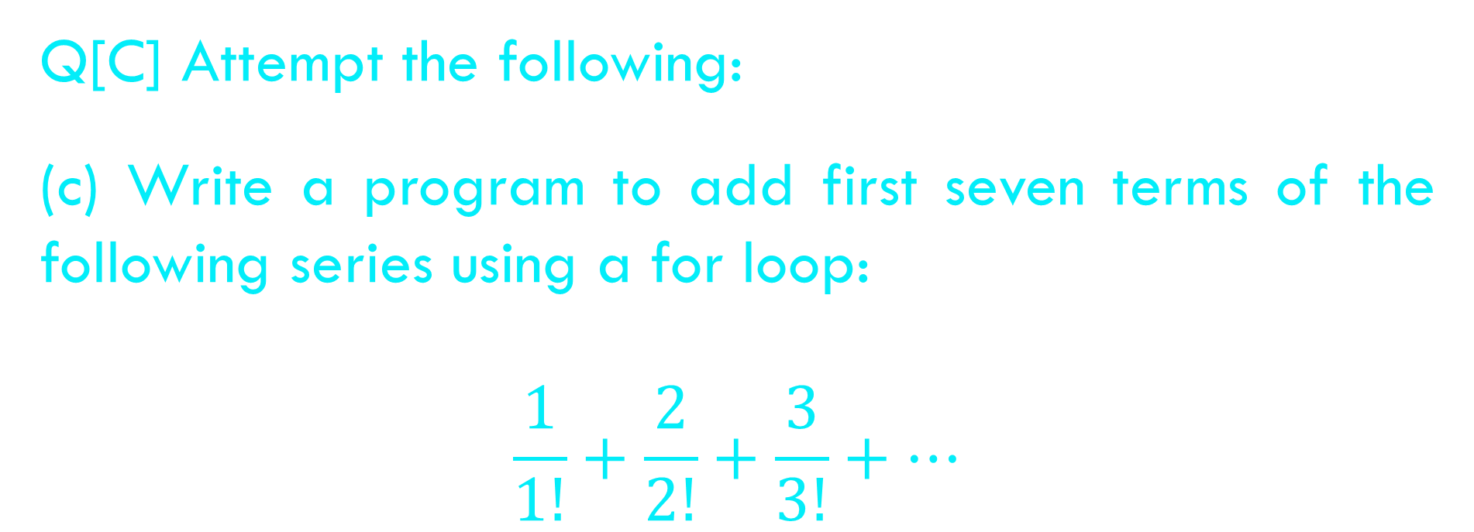
CHAPTER 6 SOLUTIONS
MORE COMPLEX REPETITIONS
Q[C] Attempt the following:
(c) Write a program to add first seven terms of the following series using a for loop:
$$\frac{1}{1!}+\frac{2}{2!}+\frac{3}{3!}+…$$
CH 6 Q[C](c)
DEAR CODING
BOOK: LET US C
BY YASHAVANT KANETKAR

Slide 29
CHAPTER 6 SOLUTIONS
MORE COMPLEX REPETITIONS
Q[C] Attempt the following:
(d) Write a program to generate all combinations of 1, 2 and 3 using for loop.
CH 6 Q[C](d)
DEAR CODING
BOOK: LET US C
BY YASHAVANT KANETKAR

Slide 30
CHAPTER 6 SOLUTIONS
MORE COMPLEX REPETITIONS
Q[C] Attempt the following:
(e) A machine is purchased which will produce earning of Rs. 1000 per year while it lasts. The machine costs Rs. 6000 and will have a salvage value of Rs. 2000 when it is condemned. If 9 percent per annum can be earned on alternate investments, write a program to determine what will be the minimum life of the machine to make it a more attractive investment compared to alternative investment?
CH 6 Q[C](e)
DEAR CODING
BOOK: LET US C
BY YASHAVANT KANETKAR

Slide 31
CHAPTER 6 SOLUTIONS
MORE COMPLEX REPETITIONS
Q[C] Attempt the following:
(f) Write a program to print the multiplication table of the number entered by the user. The table should get displayed in the following form:
29*1 = 29
29*2 = 58
…
CH 6 Q[C](f)
DEAR CODING
BOOK: LET US C
BY YASHAVANT KANETKAR

Slide 32
CHAPTER 6 SOLUTIONS
MORE COMPLEX REPETITIONS
Q[C] Attempt the following:
(g) According to a study, the approximate level of intelligence of a person can be calculated using the following formula:
i = 2 + ( y + 0.5 x )
Write a program that will produce a table of values of i, y and x. where y varies from 1 to 6, and, for each value of y, x varies from 5.5 to 12.5 in steps of 0.5.
CH 6 Q[C](g)
DEAR CODING
BOOK: LET US C
BY YASHAVANT KANETKAR

Slide 33
CHAPTER 6 SOLUTIONS
MORE COMPLEX REPETITIONS
Q[C] Attempt the following:
(h) When interest compounds q times per year at an annual rate of r% for n years, the principal p compounds to an amount a as per the following formula a = p (1 + r / q)^{nq}
Write a program to read 10 sets of p, r, n & q and calculate the corresponding as
CH 6 Q[C](h)
DEAR CODING
BOOK: LET US C
BY YASHAVANT KANETKAR

Slide 34
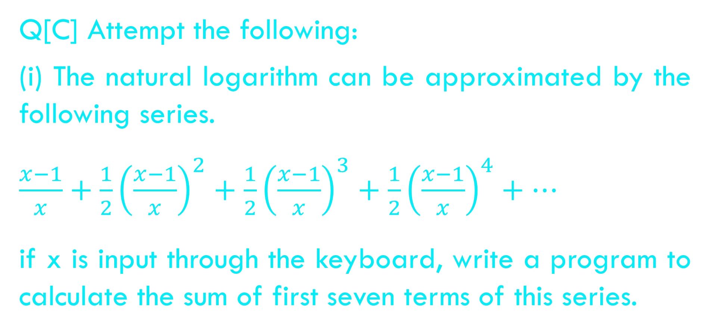
CHAPTER 6 SOLUTIONS
MORE COMPLEX REPETITIONS
Q[C] Attempt the following:
(i) The natural logarithm can be approximated by the following series.
$\frac{x−1}{x}+\frac{1}{2}{\left(\frac{x−1}{x}\right)}^{2}+\frac{1}{2}{\left(\frac{x−1}{x}\right)}^{3}+\frac{1}{2}{\left(\frac{x−1}{x}\right)}^{4}+…$
if x is input through the keyboard, write a program to calculate the sum of first seven terms of this series.
CH 6 Q[C](i)
DEAR CODING
BOOK: LET US C
BY YASHAVANT KANETKAR

Slide 35
CHAPTER 6 SOLUTIONS
MORE COMPLEX REPETITIONS
Q[C] Attempt the following:
(j) Write a program to generate all Pythagorean Triplets with side length less than or equal to 30.
CH 6 Q[C](j)
DEAR CODING
BOOK: LET US C
BY YASHAVANT KANETKAR

Slide 36
CHAPTER 6 SOLUTIONS
MORE COMPLEX REPETITIONS
Q[C] Attempt the following:
(k) Population of a town today is 100000. The population has increased steadily at the rate of 10 % per year for last 10 years. Write a program to determine the population at the end of each year in the last decade.
CH 6 Q[C](k)
DEAR CODING
BOOK: LET US C
BY YASHAVANT KANETKAR

Slide 37
CHAPTER 6 SOLUTIONS
MORE COMPLEX REPETITIONS
Q[C] Attempt the following:
(l) Ramanujan number is the smallest number that can be expressed as sum of two cubes in two different ways. Write a program to print all such numbers up to a reasonable limit.
CH 6 Q[C](l)
DEAR CODING
BOOK: LET US C
BY YASHAVANT KANETKAR

Slide 38
CHAPTER 6 SOLUTIONS
MORE COMPLEX REPETITIONS
Q[C] Attempt the following:
(m) Write a program to print 24 hours of day with suitable suffixes like AM, PM, Noon and Midnight.
CH 6 Q[C](m)
DEAR CODING
BOOK: LET US C
BY YASHAVANT KANETKAR

Slide 39
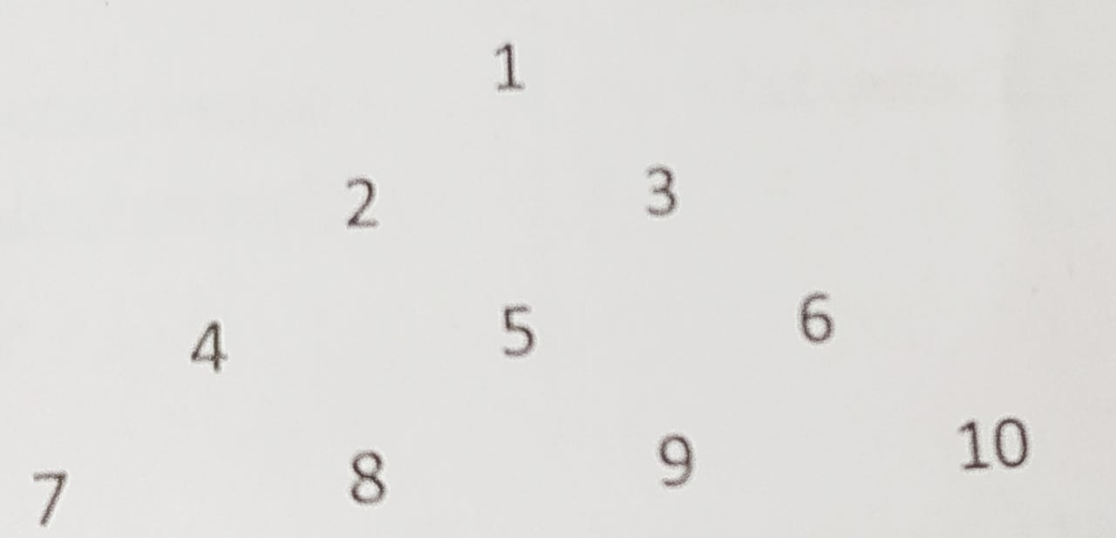
CHAPTER 6 SOLUTIONS
MORE COMPLEX REPETITIONS
Q[C] Attempt the following:
(n) Write a program to produce the following output:
CH 6 Q[C](n)
DEAR CODING
BOOK: LET US C
BY YASHAVANT KANETKAR

Slide 40
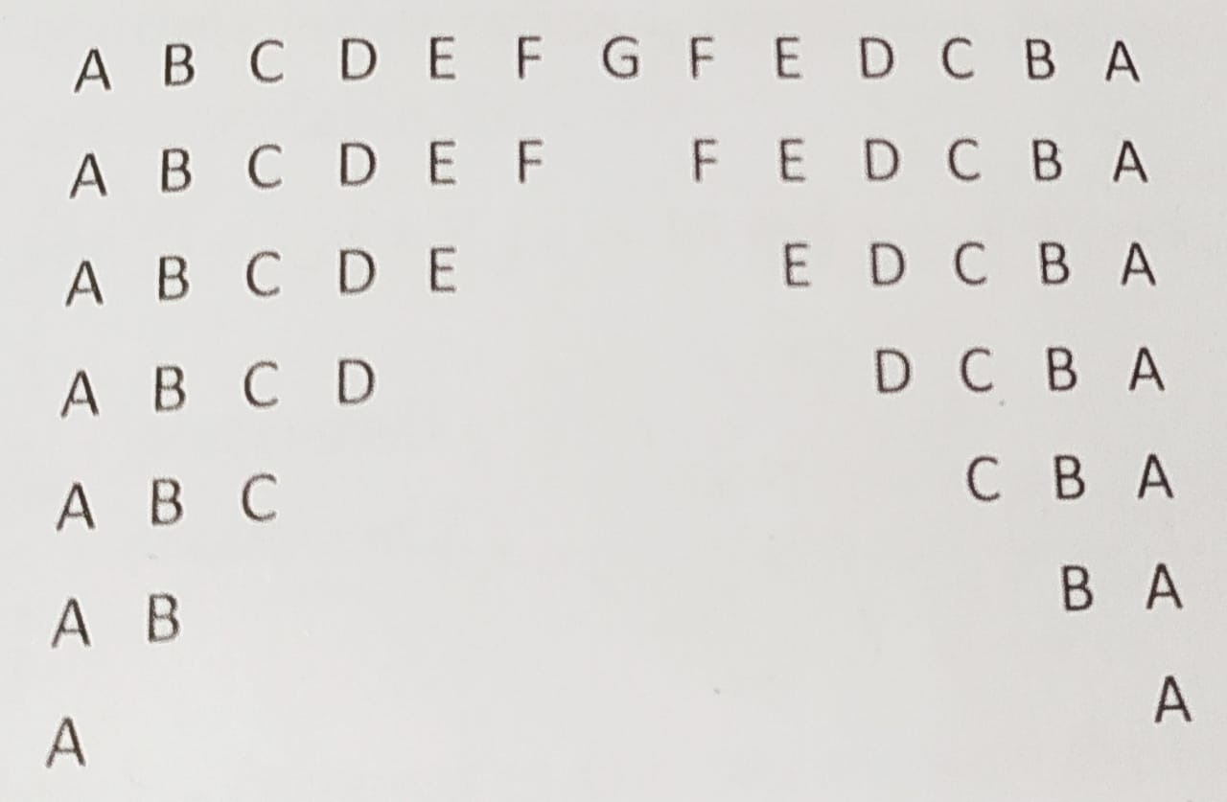
CHAPTER 6 SOLUTIONS
MORE COMPLEX REPETITIONS
Q[C] Attempt the following:
(o) Write a program to produce the following output:
CH 6 Q[C](o)
DEAR CODING
BOOK: LET US C
BY YASHAVANT KANETKAR

Slide 41
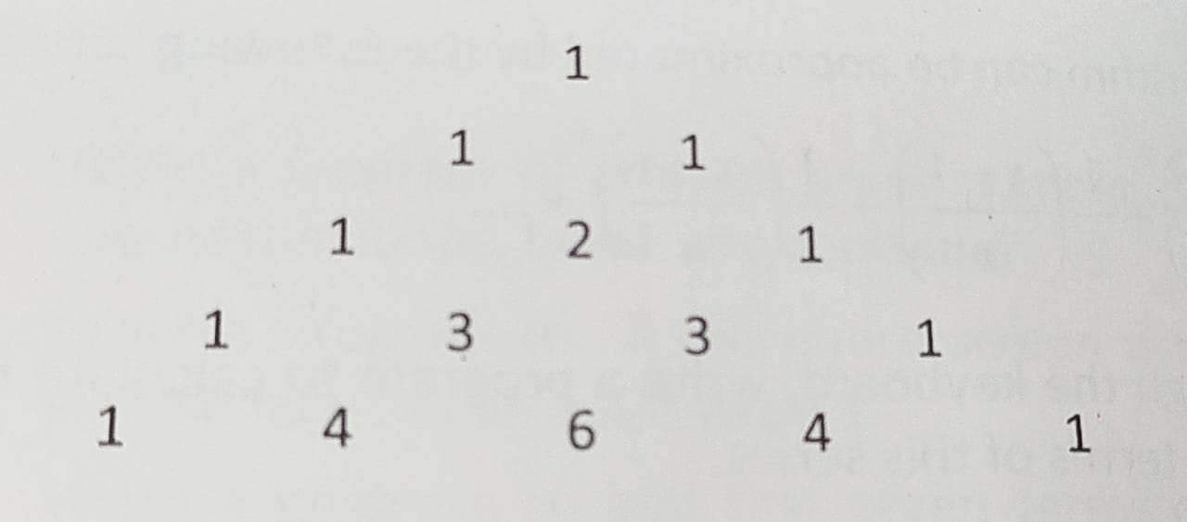
CHAPTER 6 SOLUTIONS
MORE COMPLEX REPETITIONS
Q[C] Attempt the following:
(p) Write a program to produce the following output:
CH 6 Q[C](p)
DEAR CODING
BOOK: LET US C
BY YASHAVANT KANETKAR

Slide 42
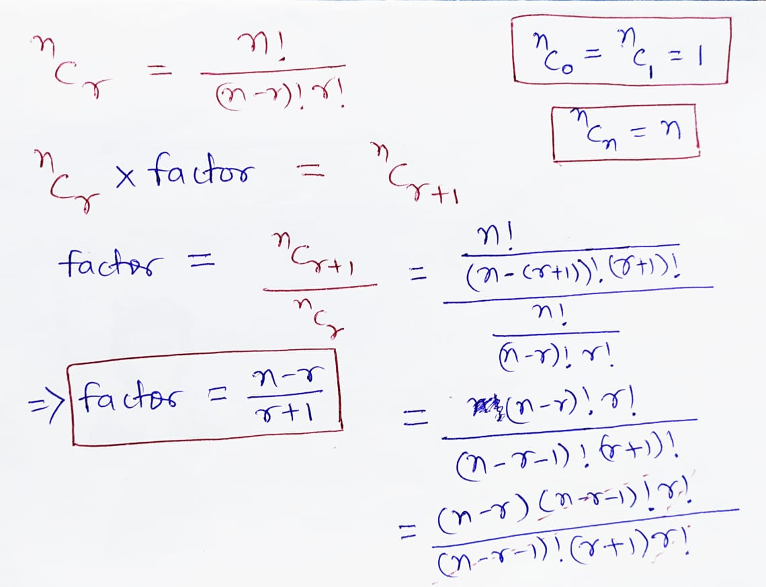
CH 6 Q[C](p)
DEAR CODING

Slide 43
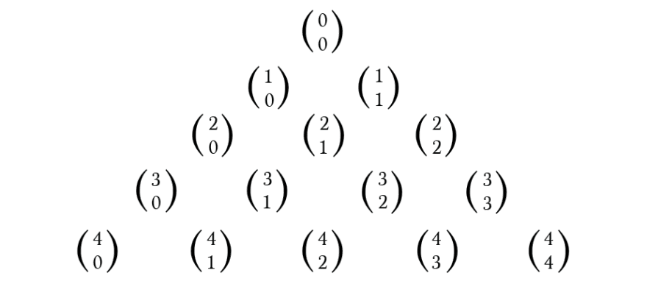
CH 6 Q[C](p)
i = 0
Binomial Coefficients
i = 1
i = 2
n = 5
CH 7 Q[D]
CH 7 Q[B]
CH 7 Q[C]
CH 7 Q[A]
i = 3
i = 4
DEAR CODING

Slide 44
LET US C
BY YASHAVANT KANETKAR
CH 7 Q[D]
CH 7 Q[B]
CH 7 Q[C]
CH 7 Q[A]
CHAPTER 7 SOLUTIONS
CASE CONTROL INSTRUCTION

Slide 45


🔴Let me create amazing coding tutorials for you forever!🙂
👇👇👇👇👇👇👇👇👇👇👇👇👇👇👇👇👇👇
👉 SUBSCRIBE 🤛
CH 7 Q[E]
CH 7 Q[C]
CHAPTER 7 SOLUTIONS
CASE CONTROL INSTRUCTION
CH 7 Q[D]
CH 7 Q[B]
Thanks for your valuable time!

Slide 46
CHAPTER 3 SOLUTIONS
DECISION CONTROL INSTRUCTION
Q[A] What will be the output of the following programs:
CH 3 Q[A]
(a)
(b)
#include <stdio.h>
int main()
{
int a = 300, b, c;
if (a >= 400)
b = 300;
c = 200;
printf("%d %d\n", b, c);
return 0;
}
#include <stdio.h>
int main()
{
int a = 500, b, c;
if (a >= 400)
b = 300;
c = 200;
printf("%d %d\n", b, c);
return 0;
}
(c)
CH 3 Q[C]
CH 3 Q[B]
(d)
(e)
DEAR CODING
(f)
BOOK: LET US C
BY YASHAVANT KANETKAR

Slide 47

CHAPTER 3 SOLUTIONS
DECISION CONTROL INSTRUCTION
(a)
#include <stdio.h>
int main()
{
int a = 300, b, c;
if (a >= 400)
b = 300;
c = 200;
printf("%d %d\n", b, c);
return 0;
}
👩‍💻 Output:
CH 3 Q[A](a)
✍️ b will contain some garbage value and c will be equal to 200.
DEAR CODING
BOOK: LET US C
BY YASHAVANT KANETKAR

Slide 48
CHAPTER 3 SOLUTIONS
DECISION CONTROL INSTRUCTION
Q[B] Point out the errors, if any, in the following C programs:
CH 3 Q[B]
(b)
(c)
(a)
#include <stdio.h>
int main()
{
int j = 10, k = 12;
if (k >= j)
{
{
k = j;
j = k;
}
}
return 0;
}
(d)
#include <stdio.h>
int main()
{
float a = 12.25, b = 12.52;
if (a = b)
printf("a and b are equal\n");
return 0;
}
(e)
(f)
DEAR CODING
(g)
BOOK: LET US C
BY YASHAVANT KANETKAR

Slide 49

CHAPTER 3 SOLUTIONS
DECISION CONTROL INSTRUCTION
(a)
#include <stdio.h>
int main()
{
float a = 12.25, b = 12.52;
if (a = b)
printf("a and b are equal\n");
return 0;
}
a == b
✅ No error!
CH 3 Q[B](a)
👩‍💻 Output:
✍️ 12.52 gets assigned to a so the if is now reduced to if ( a ) or if ( 12.52 ). Since 12.52 isn’t non zero, it is true hence printf() gets executed.
DEAR CODING
BOOK: LET US C
BY YASHAVANT KANETKAR

Slide 50
CHAPTER 3 SOLUTIONS
DECISION CONTROL INSTRUCTION
(d)
#include <stdio.h>
int main()
{
int x = 10;
if (x >= 2) then
printf("%d\n", x);
return 0;
}
CH 3 Q[B](d)
❌
ERROR!
DEAR CODING
✍️ There is no keyword "then“ in C & no variable defined here in program as well.
BOOK: LET US C
BY YASHAVANT KANETKAR

Slide 51

CHAPTER 3 SOLUTIONS
DECISION CONTROL INSTRUCTION
(d)
#include <stdio.h>
int main()
{
int x = 10;
if (x >= 2)
printf("%d\n", x);
return 0;
}
CH 3 Q[B](d)
DEAR CODING
BOOK: LET US C
BY YASHAVANT KANETKAR

Slide 52
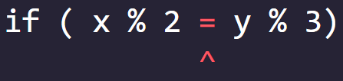
CHAPTER 3 SOLUTIONS
DECISION CONTROL INSTRUCTION
(e)
#include <stdio.h>
int main()
{
int x = 10, y = 15;
if ( x % 2 = y % 3)
printf("Carpathians\n");
return 0;
}
❌ ERROR!
CH 3 Q[B](e)
✍️ C allows only one variable on left hand side of “=“ assignment operator.
DEAR CODING
BOOK: LET US C
BY YASHAVANT KANETKAR

Slide 53
CHAPTER 3 SOLUTIONS
DECISION CONTROL INSTRUCTION
Q[C] Attempt the following:
(a) If cost price and selling price of an item are input through the keyboard, write a program to determine whether the seller has made profit or incurred loss. Also determine how much profit he made or loss he incurred.
CH 3 Q[C](a)
DEAR CODING
BOOK: LET US C
BY YASHAVANT KANETKAR

Slide 54
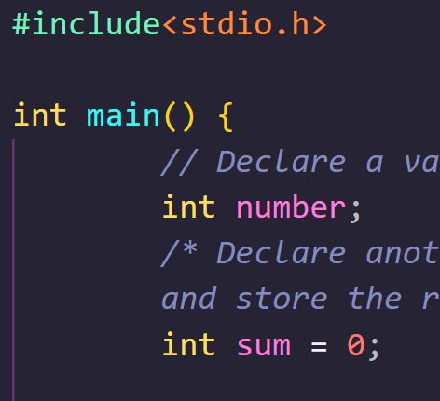
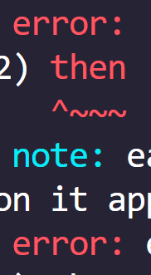

DEAR CODING

